Slide 1
INST 798/808 Concept Tracing

Slide 2
Thus Far
Large Language Models (LLMs): Deep dive into architecture to understand what kind of patterns they are learning
In qualitative research, LLMs can assist coding in two main ways: inductive (bottom-up, deriving codes from data) and deductive (top-down, applying predefined codes).
We also discussed initial strategies for evaluating LLM outputs, noting that careful validation is needed when using these models for research.

Slide 3
Today’s Focus – Concepts
Framing: So far, we learned how LLMs work and how they can code text via induction and deduction. Today, we shift to the definitions and measurement of the things we’re coding: “concepts” and “topics.”
We’ll examine what social science concepts are, how they relate to topics in language, and how to rigorously define and measure them (operationalization).
Key question: How can LLMs help us identify and label concepts/topics in text? And how might they complicate the process?

Slide 4
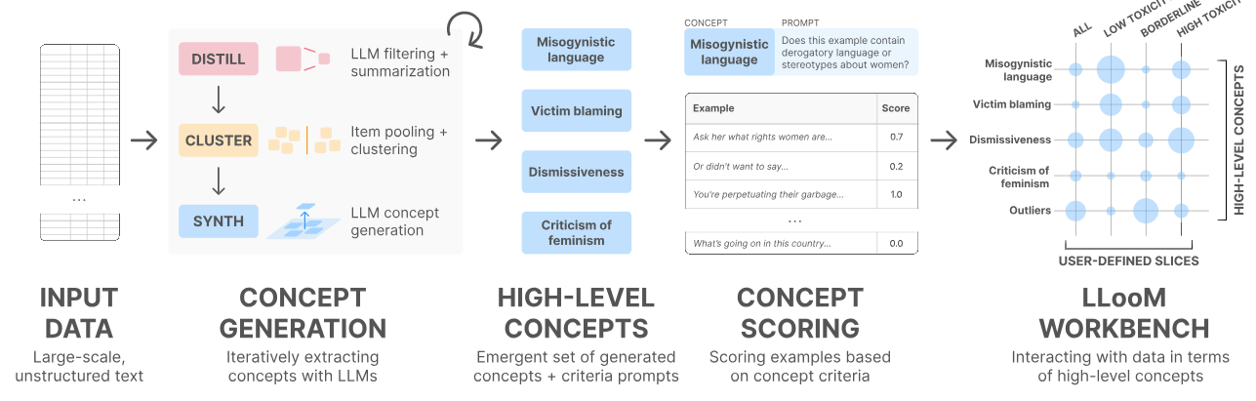
What Is a Concept?
We’ve seen one definition from LOOM (Lam et al. 2024):
“highlevel concepts, which we define as human-interpretable descriptions defined by explicit inclusion criteria.”

Slide 5
What Is a Concept? Philosophical Perpsectives
In philosophy (and early social science), a concept is often seen as an abstract idea or a category for classifying reality.
Classic view: concepts have essential features (Aristotle’s view – necessary and sufficient conditions).
Example: The concept bird might be defined classically by features (has feathers, lays eggs, etc.). If an entity has all the features, it’s a bird; if not, it isn’t. This yields clear but sometimes overly rigid boundaries.
Wittgenstein challenged this with family resemblance – many categories don’t have one essence, but a series of overlapping similarities.
Modern view: concepts have prototypes (typical examples) rather than firm boundaries.

Slide 6
Defining “Concepts” – Cognitive Science and Prototypes
Prototype theory (Rosch, 1970s): People cognitively represent concepts not by strict rules, but by a prototype – an ideal or most typical example. Other instances are included based on similarity to the prototype.
Concepts have a graded structure: membership is not all-or-nothing. This is why we see debates like “is a hotdog a sandwich?” – different people weigh features differently.
Cognitive economy: Prototypes help us make quick judgments (if something closely matches the prototype, we classify it faster). But the downside is fuzzy boundaries.
Implication for measurement: When coding data, humans (and LLMs) might default to prototypical cases. They might struggle on edge cases. We should consider this when defining categories for an AI: provide guidance on borderline instances to avoid misclassification.

Slide 7
High-Level Operational Definition
An abstraction
A mental representation
Finds similarities across instances
Different types of birds
Different observations of a system over time (e.g. capitalism, democracy, etc)
A label (not strictly necessary)

Slide 8
From Concepts to Measurement – Operationalization
Often, concepts are latent (not directly observable). We choose indicators that reflect the concept.
Example: Concept = Socioeconomic Status (SES) (abstract). Operationalization might use indicators like income, education level, and occupation as measurable proxies.
Example: Concept = Political ideology of a text. Operationalize by coding the text as {Liberal, Moderate, Conservative} based on keywords or expert judgment, or a spectrum score from -1 (left) to +1 (right).
A good operational definition is clear, measurable, and reproducible. It defines what is and isn’t an instance of the concept in terms of data.
Multiple measures: Sometimes a concept can be measured in more than one way. It’s good practice to test if results hold across different operationalizations (robustness checks).
Implication for LLM use: When using LLMs to label or extract concepts, we must essentially give the model an operational definition. This might be done by prompt instructions (e.g., describing the concept and criteria). If the definition is vague, the model might use its own interpretation, which could be inconsistent. Clear prompt = clear operationalization.

Slide 9
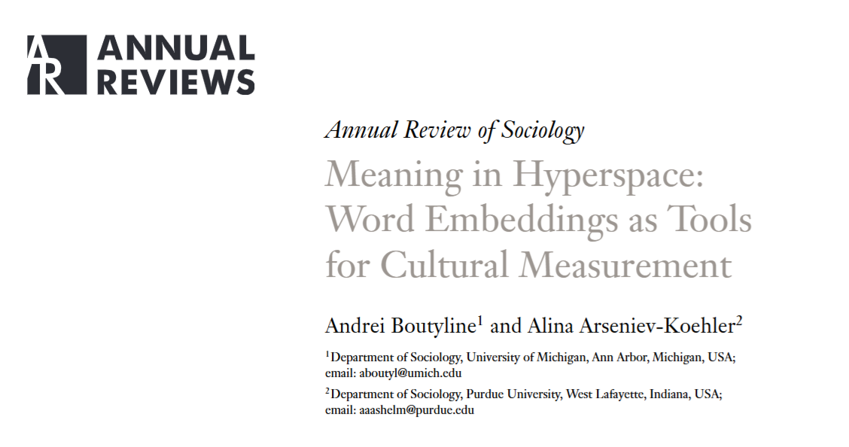
Do Words Vectors Capture Concepts?

Slide 10
Motivation & Core Question
Rise of embeddings in sociology as “hyperspace” tools for cultural measurement
Core gap: What do these vector‐space models actually measure, and does that align with the social concepts we care about?
Their focus: Distinguish context spaces (usage patterns) from concept spaces (socially meaningful features).

Slide 11
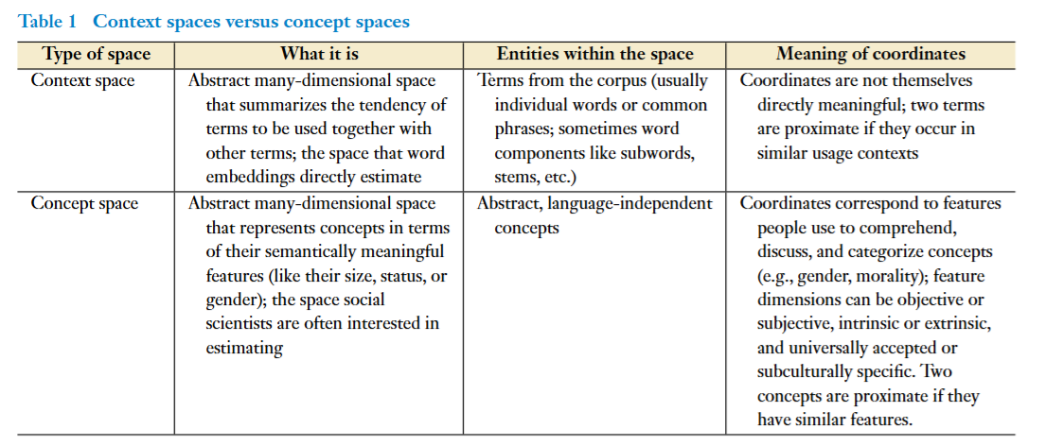
Comparing Context Vs Concept

Slide 12
Why They Differ
Words ≠ Concepts
Embeddings locate words; concepts are regions in a space of features
Arbitrary Orientation
Embedding axes can rotate/scale arbitrarily—no inherent feature alignment
Fuzzy Regions vs. Points
Concepts occupy graded, convex regions (Rosch’s prototypes), not single vectors

Slide 13
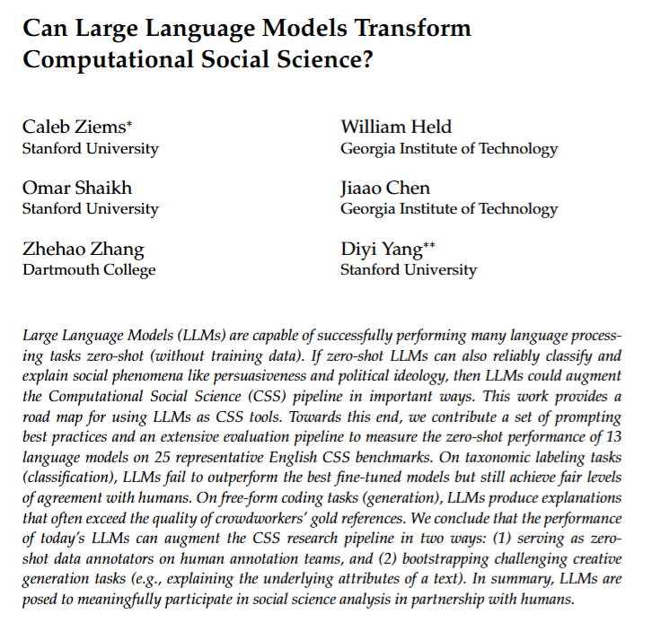

Slide 14
LLMs for CSS Concept Coding (Ziems et al. 2024)
Context: They explore using LLMs as tools in Computational Social Science (CSS) to do tasks that normally require human-coded data. Specifically, can LLMs zero-shot classify and explain social phenomena (like persuasiveness, ideology, etc.)?
Scope: Evaluated 13 LLMs (open-source and API models) on 25 CSS tasks across domains – politics, sociology, psychology, etc.. Tasks include: sentiment classification, hate speech detection, stance detection, persuasion techniques, event extraction, semantic change, etc. They cover both taxonomic labeling tasks (classification) and free-form coding tasks (generative explanations).

Slide 15
(Continued)
Approach: Developed prompting best practices and an evaluation pipeline. All tasks are done zero-shot (no fine-tuning on task-specific data). For classification tasks, the model must choose a label; for generation tasks, it must produce an explanatory text.
Goal: Understand if and how LLMs can augment or replace parts of the social science research pipeline: can they serve as reliable annotators? Do they generalize across domains? How do they compare to traditional supervised models and human annotators?

Slide 16
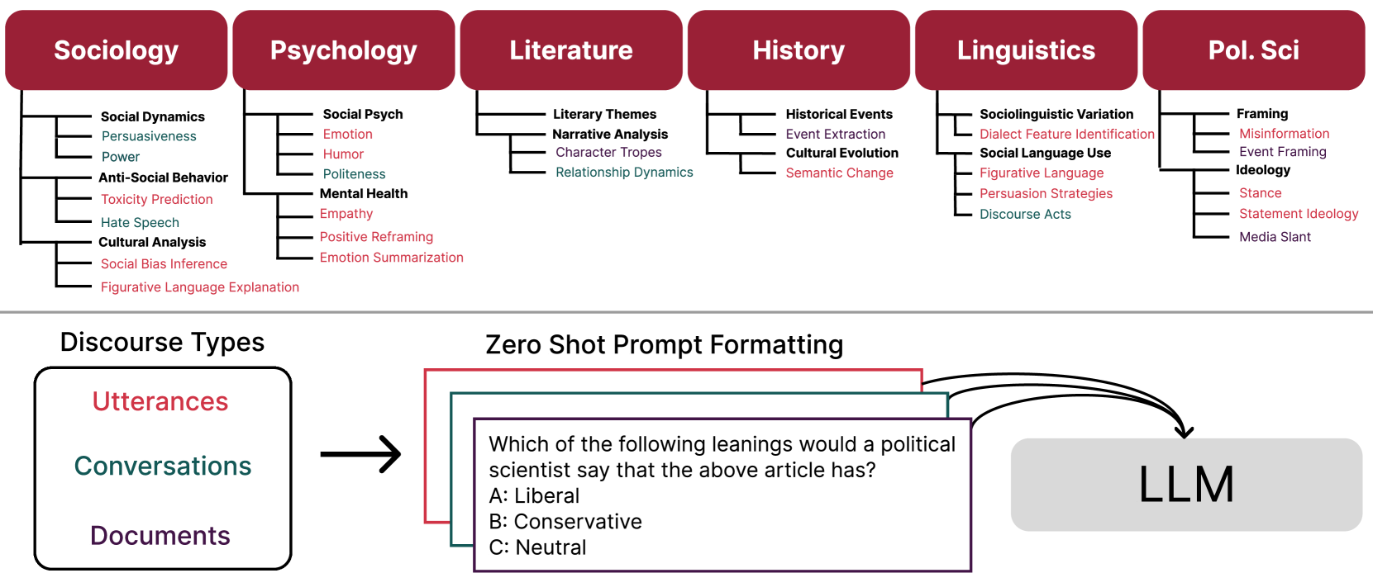

Slide 17
Tasks and Prompting
Zero-shot prompt formatting: They crafted prompts for each task. Usually this involved a short instruction and possible outputs. Example prompt (political leaning task): “Which of the following leanings would a political scientist say that the above article has? A: Liberal B: Conservative C: Neutral”, then provide the article text, then ask the model to choose.
For generative tasks, prompts might say: “Explain why the following tweet could be offensive” or “Reframe the statement in a positive way.” The prompt style was standardized as much as possible across models.

Slide 18
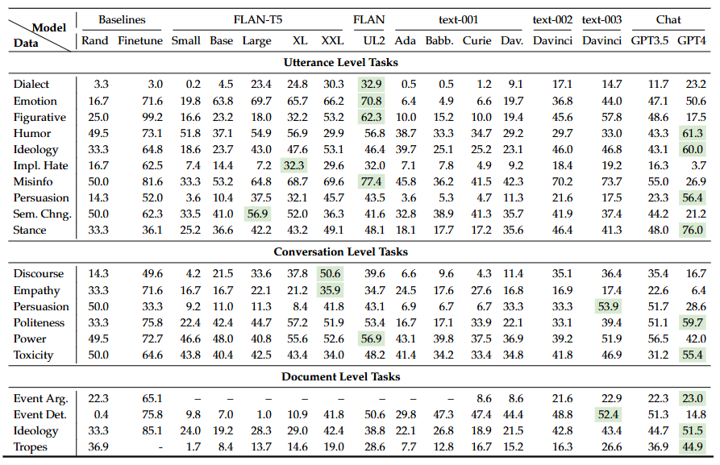

Slide 19
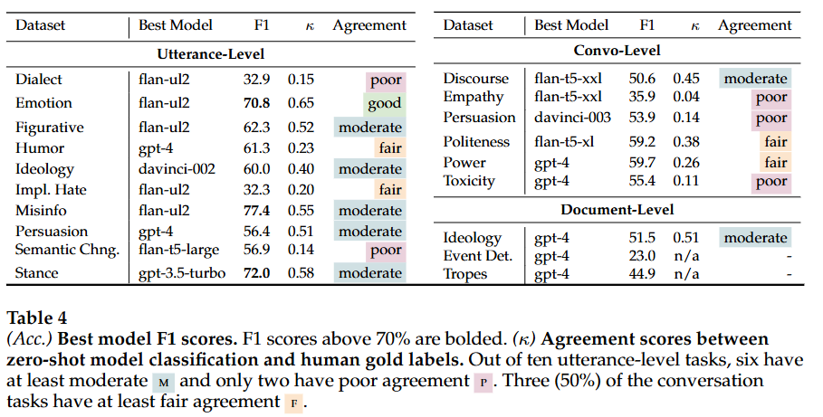

Slide 20
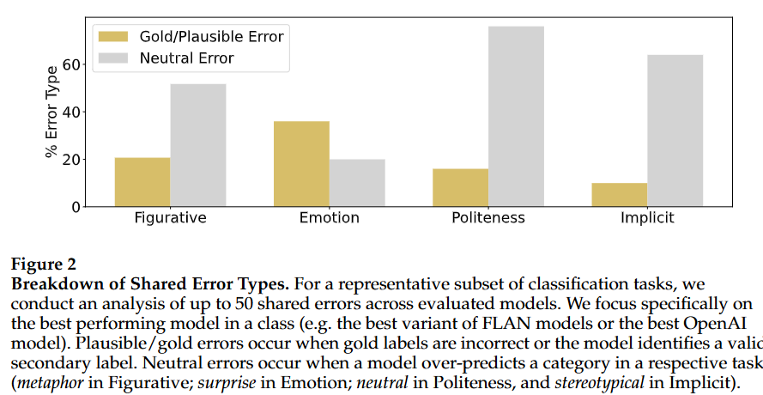

Slide 21
Results – Classification (Deductive Labeling) Performance
On taxonomic labeling tasks (classification with predefined categories), zero-shot LLMs achieved moderate success but generally did not outperform fine-tuned specialist models.
For example, across tasks like ideology detection, hate speech classification, etc., the best zero-shot LLM’s accuracy/F1 was usually a bit lower than a supervised model trained on that task. The paper notes zero-shot results “rarely exceed the carefully-tuned supervised RoBERTa baselines”.
However, LLMs often reached fair agreement with human labels. In many cases, GPT-3.5’s predictions aligned with human annotations reasonably well (far better than chance, though not perfect). This suggests LLMs know a lot about these categories, just not consistently enough to beat dedicated models.

Slide 22
Result (continued)
Model size & tuning mattered: They observed larger, instruction-tuned models perform better. For instance, GPT-3.5 (175B params, with instruction fine-tuning) outperformed smaller models.
Error analysis: A common error type was LLMs defaulting to overly broad or common labels instead of nuanced ones. E.g., in a bias classification task, GPT-3.5 often chose a generic label “stereotype” instead of a more specific category like “racial bias” vs “political bias,” missing finer distinctions. This hints that without fine-tuning, models may lean on general knowledge and ignore niche taxonomy differences.
Takeaway: Zero-shot LLMs can replicate a lot of classification coding, but some precision is lost. They’re roughly equivalent to a decent crowdworker or a mid-tier model – useful for assisting, but not yet replacing a well-trained classifier or careful human coder in terms of accuracy.

Slide 23
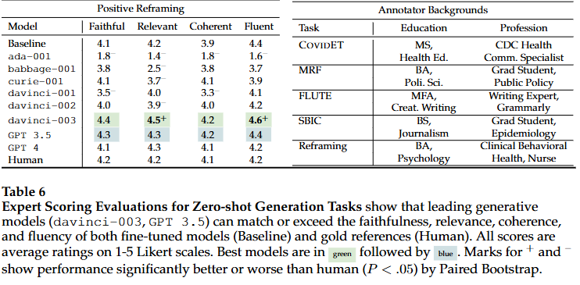
Text Generation

Slide 24
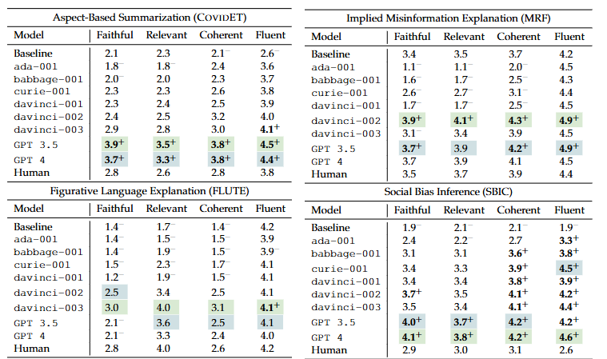

Slide 25
Generation
Takeaway: For tasks that require articulating a concept in natural language (why something is X, or summarizing how X is present), today’s LLMs are extremely capable. They can effectively perform inductive coding by generating narrative that captures the concept, making them useful for tasks like writing codebook descriptions, summarizing themes, or providing rationales.

Slide 26
Takeaways from Ziems et al.
LLMs can augment human coders
Efficiency gains
Still not a replacement
Model choice matters
Evaluation innovation needed

Slide 27


Slide 28
Case Study 2 – Inductive Concept Mapping (Garg & Fetzer 2025)
Paper: “Causal Claims in Economics” by Prashant Garg & Thiemo Fetzer, 2025.
Goal: Analyze a large corpus of economics research papers to map out how economic concepts are related and how the use of causal inference has grown and impacted the field. Essentially, they wanted to discover and catalog concepts and their relationships (especially causal relationships) at scale.
Data: Over 44,000 working papers (NBER and CEPR series) from 1980–2023. These are unpublished but influential research papers. This is a huge amount of text – thousands of papers, millions of words – far beyond manual coding capacity.

Slide 29
Approach I
Approach: They built a custom pipeline using an LLM to extract structured knowledge (who is doing what to what, causally) from each paperar5iv.org. This yields a knowledge graph for each paper: nodes are economic concepts, edges are relationships where one concept affects another. They specifically mark edges as causal if the paper uses an identification strategy (like an experiment or instrumental variable) for that relationshipar5iv.orgar5iv.org.
Focus on “causal claims”: A causal claim is basically an assertion that X causes or affects Y, supported by a causal inference method. They distinguished those from general claims (correlations or theoretical links without causal identification).

Slide 30
Approach II
Research questions: How has the prevalence of causal research changed over time (“credibility revolution”)? Does making more complex causal arguments lead to better publication outcomes or more citations? Does novelty in conceptual connections matter, and does it matter more when those connections are causal? Are papers that connect well-known concepts treated differently from those exploring fringe connections?
In short, they’re using LLMs to inductively identify concepts (economic topics) and relationships from text, then examining patterns and impacts in that conceptual space.

Slide 31
Building Causal Knowledge Graphs
Corpus: 44 k+ NBER & CEPR working papers (1980–2023) arXiv
Node Extraction:
Use a custom LLM pipeline to pull out every “source” and “sink” variable mentioned in text.
Map each free‐text variable to a standardized JEL code via semantic embeddings.
Edge Construction:
General claims → directed edges in gray
Causal claims → colored edges labeled by inference method (DiD, IV, RDD, RCT)
Graph View:
Each paper ⇒ its own mini‐graph of interlinked economic concepts.
Full dataset ⇒ a massive, evolving “meta‐graph” tracking the rise of causal inference over time.

Slide 32
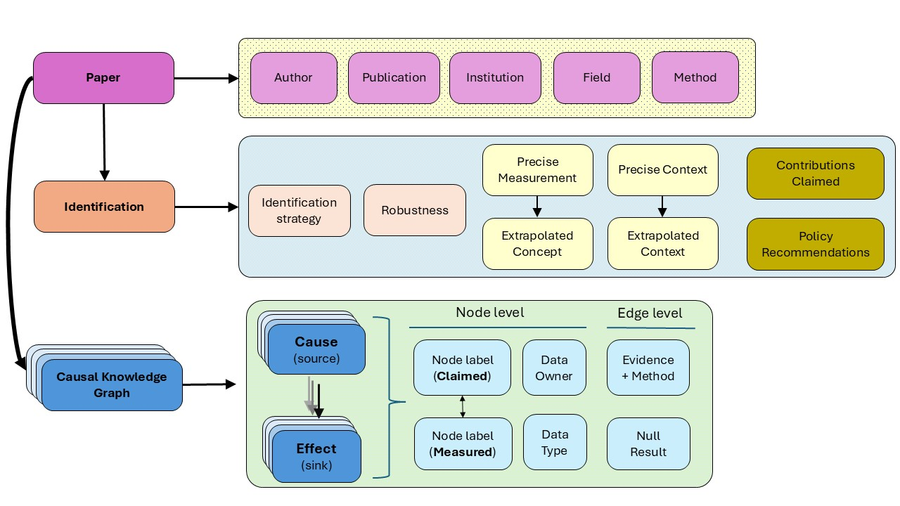

Slide 33
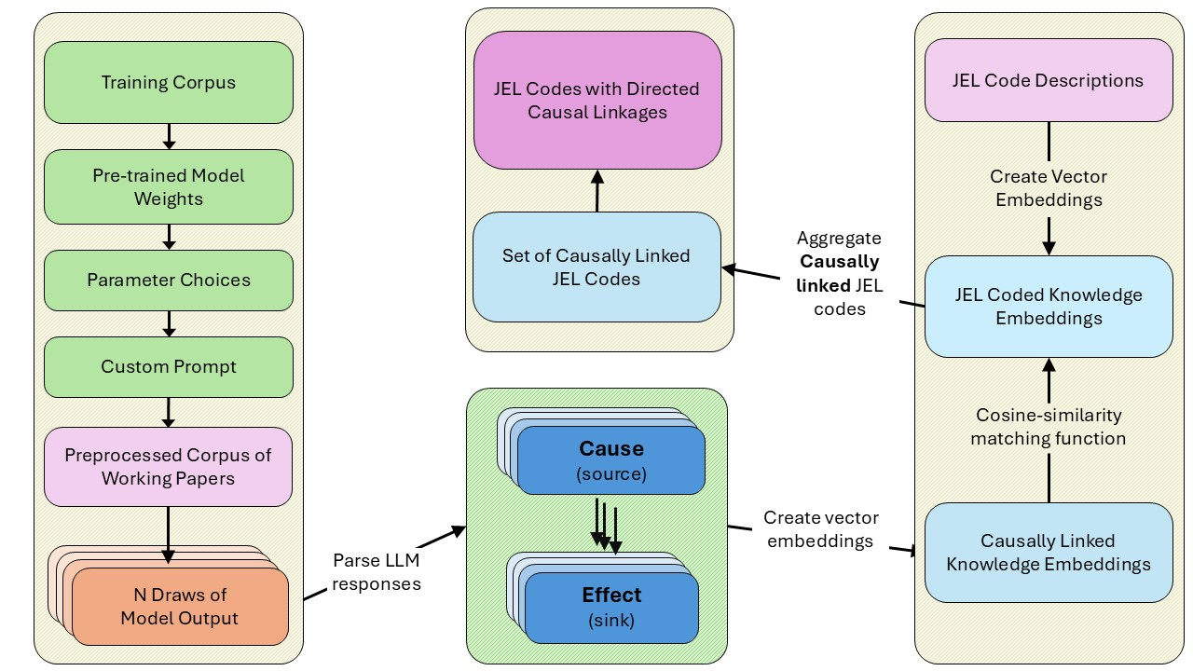

Slide 34
Prompt for Stage 1: Curated Summary
In Stage 1, the assistant was instructed to analyze the first 30 pages of the paper and extract a curated summary of key elements. The system instructions included:
Assistant’s Role: An expert assistant specializing in analyzing economics papers.
Task: Extract specific information related to research questions, causal identification strategies, data usage, data accessibility, acknowledgements, and metadata.
Guidelines: Provide clear, detailed, and information-rich responses for each field. Focus exclusively on specified sections. Adhere strictly to specified formats and instructions.
Fields to Extract: Research questions from the abstract, introduction, and full text; causal identification information; causal claims; framing and policy implications; data and units of analysis; data accessibility; institutional and author-level information; acknowledgements.

Slide 35
Prompt for Stage 2: Causal Graph Retrieval
In Stage 2, the assistant was tasked with extracting detailed causal relationships from the summaries provided in Stage 1. The system instructions included:
Assistant’s Role: An expert assistant specializing in analyzing economics papers.
Task: Extract an exhaustive list of causal relationships from provided texts, capturing all intermediate steps, mediators, confounders, and other relevant nodes in the causal graph (DAG).
Guidelines: Be exhaustive in extraction. Use exact terms from the authors. Provide each causal relationship in a structured format with specified fields.
Fields to Extract: For each causal relationship, include the causal claim, cause, effect, type of causal relationship, whether evidence is provided, sign of impact, effect size, statistical significance, causal inference method, sources of exogenous variation, level of tentativeness.

Slide 36
Prompt for Stage 3: Data and Accessibility
In Stage 3, the assistant was instructed to extract structured information regarding data sources and accessibility from the data-related summaries in Stage 1. The system instructions included:
Assistant’s Role: An expert assistant specializing in analyzing economics papers.
Task: Extract specific pieces of information related to data and units of analysis, and data accessibility.
Guidelines: Carefully extract information for each field, adhering strictly to definitions and instructions. Use exact wording from the text when possible.
Fields to Extract: Data usage indicators, total number of observations, units of analysis, data granularity, temporal and geographical context, data ownership, data accessibility, ethical considerations.

Slide 37
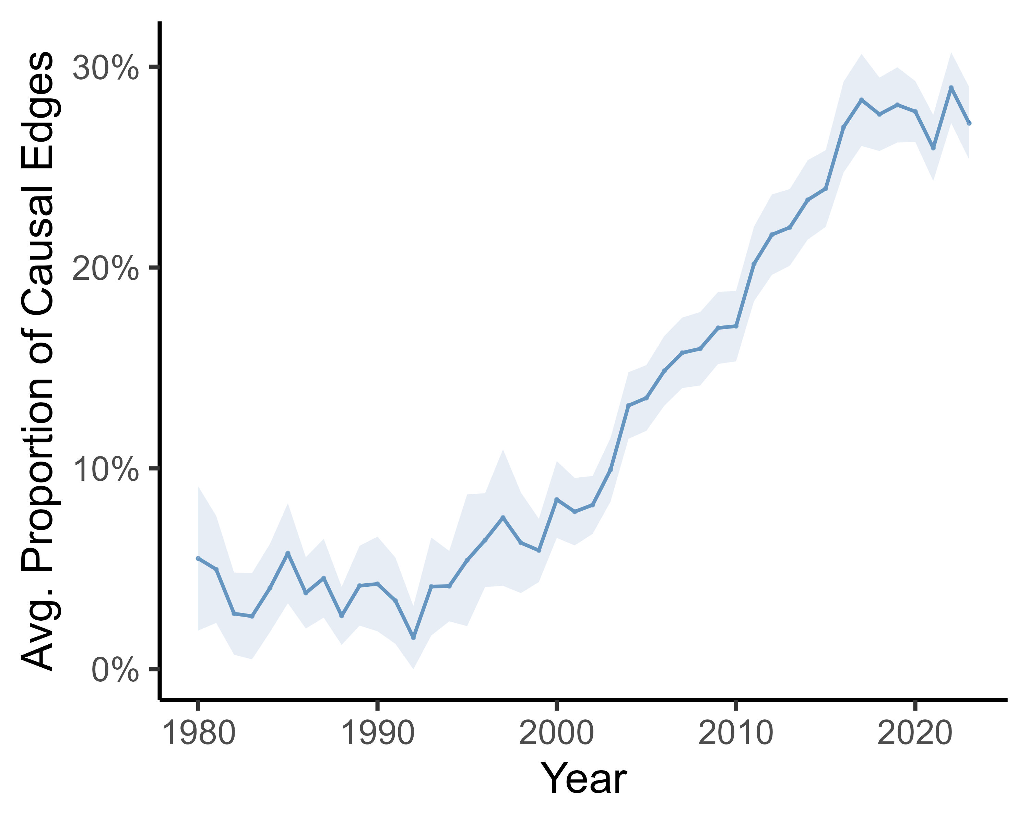

Slide 38
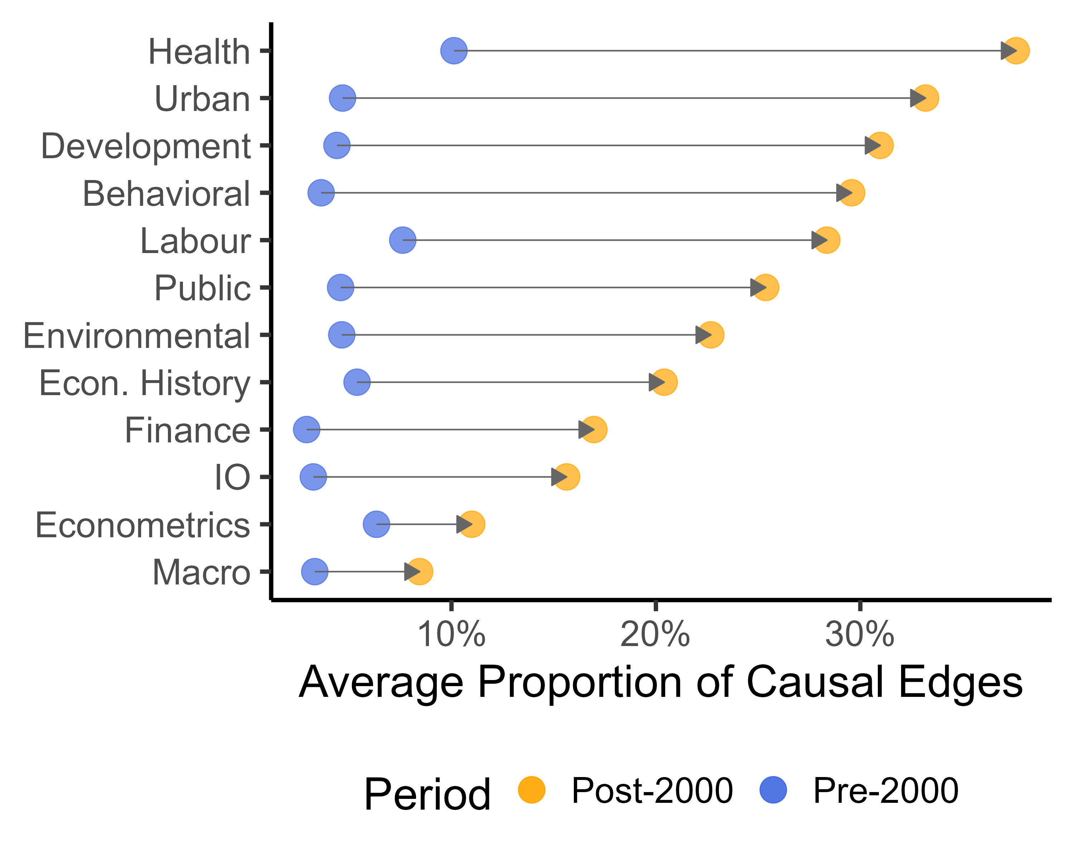

Slide 39
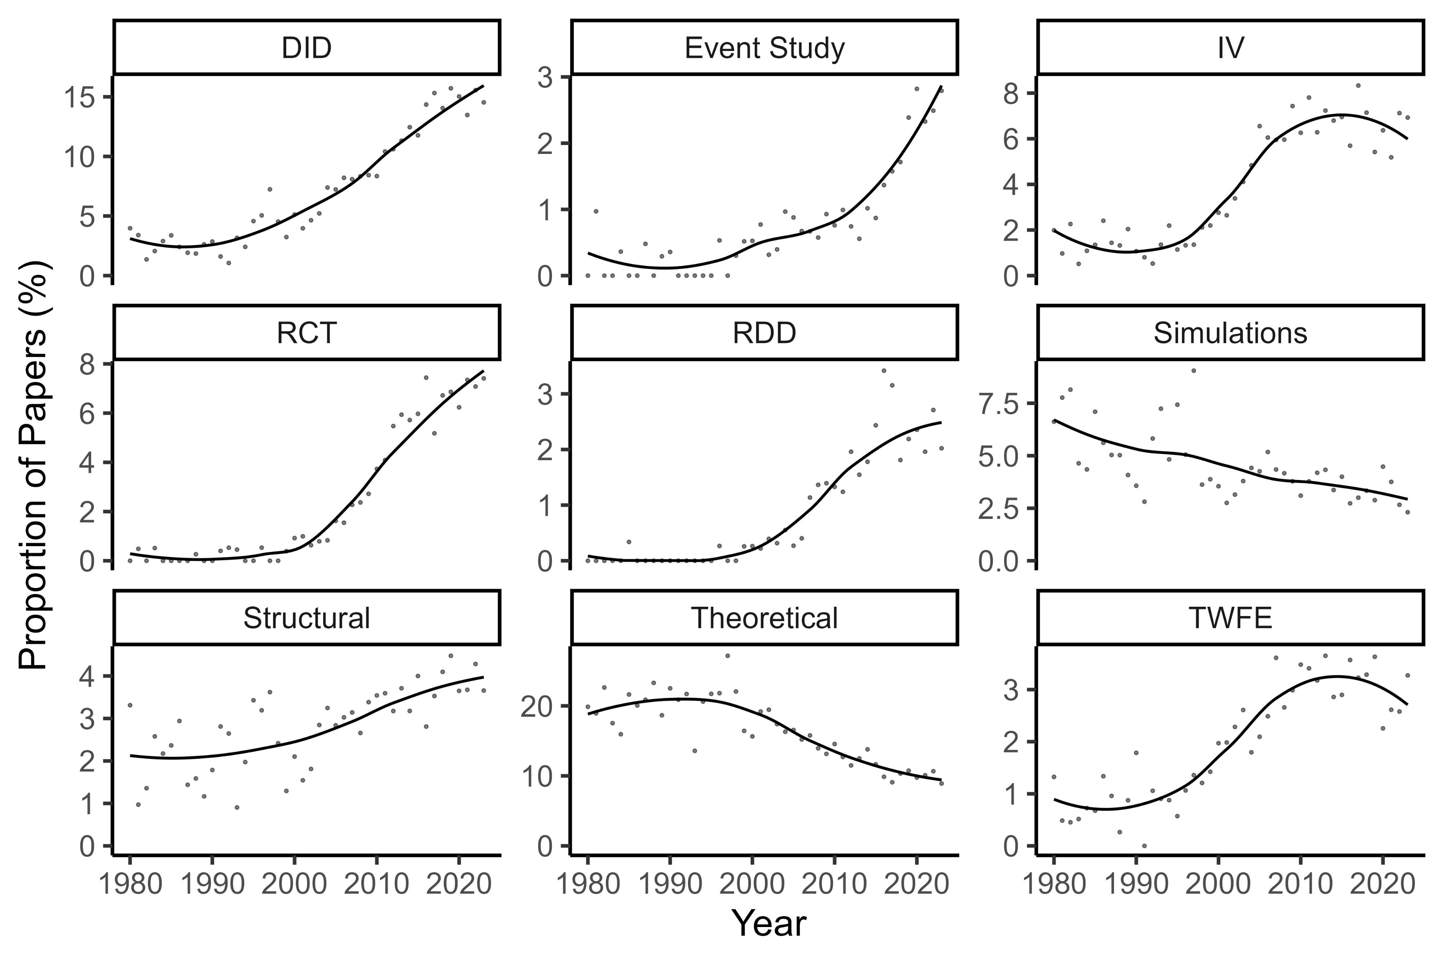

Slide 40
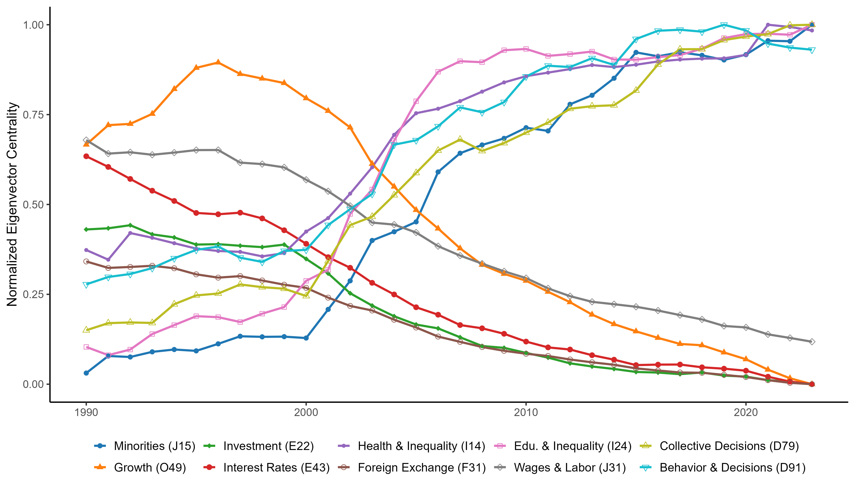

Slide 41
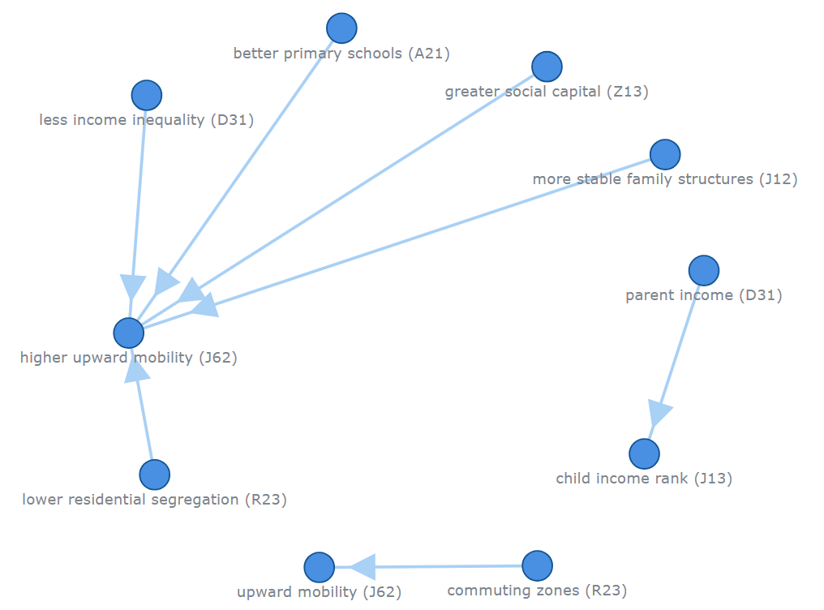

Slide 42
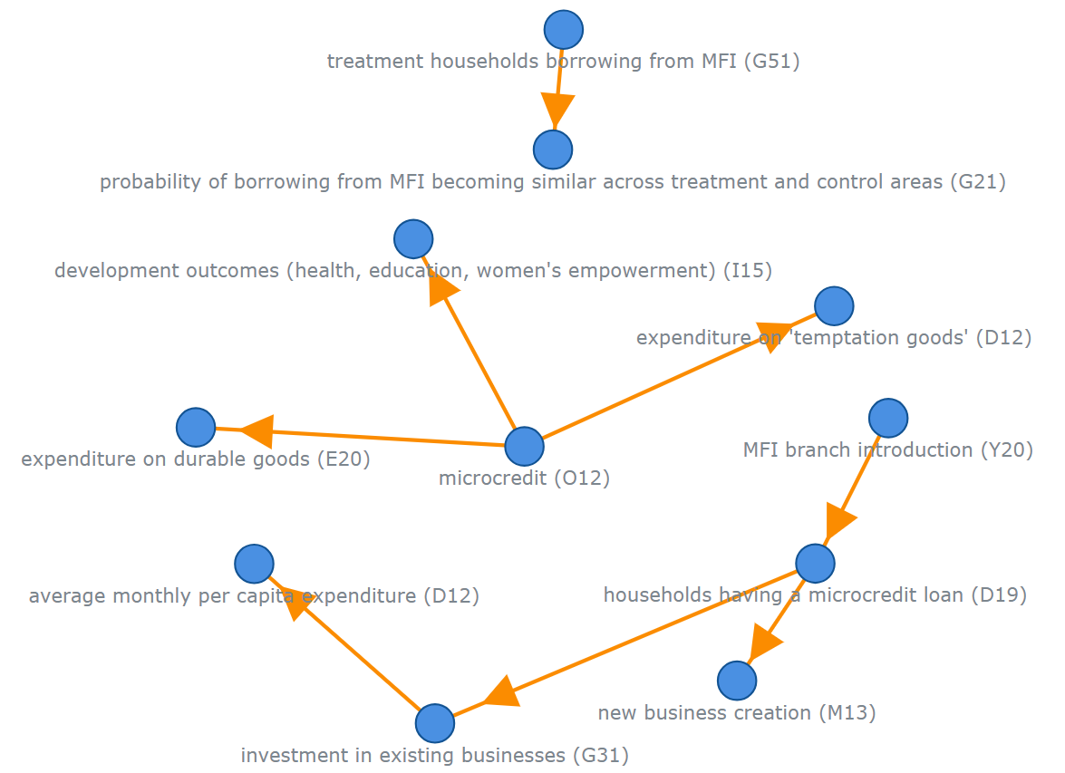

Slide 43
Findings
Using central, well-known concepts (highly connected nodes in the global knowledge graph) had mixed effects:
Papers that revolve around popular concepts (e.g., “Economic Growth”, “Unemployment Rate”) tended to receive more citations on average. This makes sense – if you work on a central topic, more people care and cite it.
However, those papers didn’t have a higher likelihood of top-5 publication
Bridging underexplored gaps: Papers that linked two underexplored concepts (ones rarely studied together) – essentially high gap-filling proportion – got recognition primarily if the link was causal. If done with causal rigor, bridging gaps could help in publication (as a novel contribution).

Slide 44
Findings
Implication: Tackling big, central concepts ensures relevance and citation potential, but to get into top journals, you often need to bring something new (a new combination or a new causal insight). Bridging topics can provide that novelty, but it’s not a guaranteed recipe for high impact unless that bridge opens a sustained new avenue of research.
Balance: The most successful papers might be those that connect a central concept with a novel causal insight (combining importance and novelty). E.g., showing a new causal factor for a major outcome like economic growth – important and new.

Slide 45
Limitations of JEL-Based Concept Mapping
Broad categories: JEL codes, while convenient and interpretable, are coarse-grained. Each code covers a broad area. This means nuances can be lost – two very different variables might map to the same JEL code. E.g., “high school graduation rate” and “college enrollment” both fall under Education (I2)
One code per concept
Reliance on LLM extraction quality might not capture a subtle causal nuance. Thus some edges or nodes might be omitted or mislabeled.
Static mapping vs. dynamic concepts: JEL codes themselves might not cover conceptual evolution. For instance, “gig economy” wasn’t a thing in 1980, and there’s no specific JEL code for it

Slide 46
Conclusion
Synthesis: LLMs offer powerful capabilities to define, label, and even discover concepts and topics across text data. They can inductively reveal patterns (like Garg & Fetzer’s causal maps) and deductively apply frameworks (like Ziems et al.’s concept labels) at scales unimaginable before.
Discussion Question:
What other interesting things could we do with causal claims?
Could this type of extraction be applied at scale to other domains?
Based on the architecture of LLMs, is it harder to detect or infer concepts?
Closing thought: Using LLMs for concept measurement demands careful operationalization, validation, and ethical reflection.

